Slide 1
Extracted information
eWalker team

Slide 2
user_files/.mc/history
[inpCreate a new Directory]
0=retrieved_files
1=DFRWS
[Dir Hist New Right Panel]
0=/home/stevev
1=/mnt
2=/mnt/hgfs
3=/mnt/hgfs/Admin_share
4=/media
5=/media/disk
6=/media/disk/DFRWS
[cmdline]
0=cd /mnt/hgfs
1=cd /media
[Dir Hist New Left Panel]
0=/home/stevev/.Trash
1=/home/stevev/.config
2=/home/stevev/.eggcups
3=/home/stevev/.evolution
4=/home/stevev/.gconf
5=/home/stevev/.gconfd
6=/home/stevev/.gstreamer-0.10
7=/home/stevev/.gnome2_private
8=/home/stevev/.gnome2
9=/home/stevev/.gnome/gnome-vfs
10=/home/stevev/.gnome
11=/home/stevev/temp
12=/home/stevev

Slide 3
user_files/.mc/ini
[Midnight-Commander]
show_backups=1
show_dot_files=1
verbose=1
mark_moves_down=1
pause_after_run=1
shell_patterns=1
auto_save_setup=1
auto_menu=0
use_internal_view=1
use_internal_edit=1
clear_before_exec=1
mix_all_files=0
fast_reload=0
fast_reload_msg_shown=0
confirm_delete=1
confirm_overwrite=1
confirm_execute=0
confirm_exit=1
confirm_directory_hotlist_delete=1
safe_delete=0
mouse_repeat_rate=100
double_click_speed=250
use_8th_bit_as_meta=0
confirm_view_dir=0
mouse_move_pages=1
mouse_move_pages_viewer=1
fast_refresh=0
navigate_with_arrows=0
drop_menus=0
wrap_mode=1
old_esc_mode=0
cd_symlinks=1
show_all_if_ambiguous=0
max_dirt_limit=10
torben_fj_mode=0
use_file_to_guess_type=1
alternate_plus_minus=0
only_leading_plus_minus=1
show_output_starts_shell=0
panel_scroll_pages=1
xtree_mode=0
num_history_items_recorded=60
file_op_compute_totals=1
vfs_timeout=60
ftpfs_directory_timeout=900
use_netrc=1
ftpfs_retry_seconds=30
ftpfs_always_use_proxy=0
ftpfs_use_passive_connections=1
ftpfs_use_unix_list_options=1
ftpfs_first_cd_then_ls=1
fish_directory_timeout=900
editor_word_wrap_line_length=72
editor_key_emulation=0
editor_tab_spacing=8
editor_fill_tabs_with_spaces=0
editor_return_does_auto_indent=1
editor_backspace_through_tabs=0
editor_fake_half_tabs=1
editor_option_save_mode=0
editor_option_save_position=1
editor_option_auto_para_formatting=0
editor_option_typewriter_wrap=0
editor_edit_confirm_save=1
editor_syntax_highlighting=1
nice_rotating_dash=1
horizontal_split=0
mcview_remember_file_position=0
editor_backup_extension=~
[Layout]
equal_split=1
first_panel_size=53
message_visible=1
keybar_visible=1
xterm_title=1
output_lines=0
command_prompt=1
menubar_visible=1
show_mini_info=1
permission_mode=0
filetype_mode=1
free_space=1
[Dirs]
other_dir=/media/disk/DFRWS
current_is_left=1
[Panelize]
Find *.orig after patching=find . -name \*.orig -print
Find SUID and SGID programs=find . \( \( -perm -04000 -a -perm +011 \) -o \( -perm -02000 -a -perm +01 \) \) -print
Find rejects after patching=find . -name \*.rej -print
[New Left Panel]
display=listing
reverse=0
case_sensitive=1
sort_order=name
list_mode=full
user_format=half type name | size | perm
user_status0=half type name | size | perm
user_status1=half type name | size | perm
user_status2=half type name | size | perm
user_status3=half type name | size | perm
user_mini_status=0
[New Right Panel]
display=listing
reverse=0
case_sensitive=1
sort_order=name
list_mode=full
user_format=half type name | size | perm
user_status0=half type name | size | perm
user_status1=half type name | size | perm
user_status2=half type name | size | perm
user_status3=half type name | size | perm
user_mini_status=0
[Misc]
ftpfs_password=anonymous@
ftp_proxy_host=gate
display_codepage=Other_8_bit

Slide 4
user_files/.gnome/gnome-vfs/ .trash_entry_cache
/media/disk -
/dev -
/dev/shm -
/boot -

Slide 5
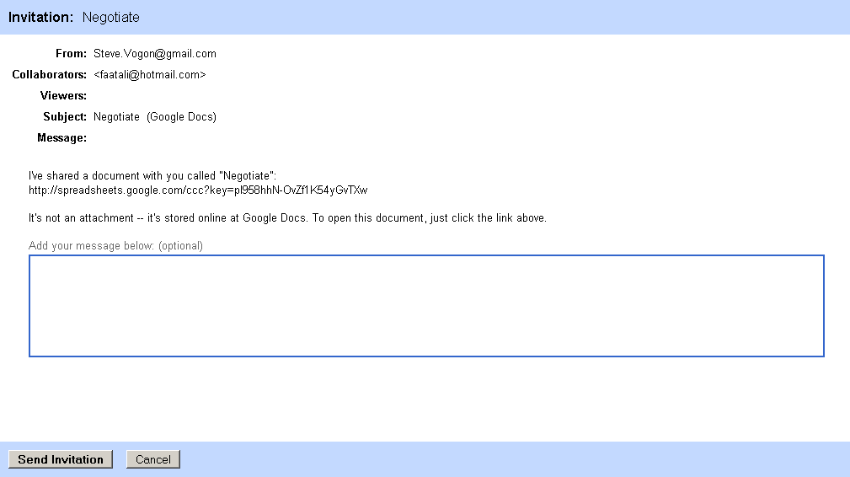

Slide 6
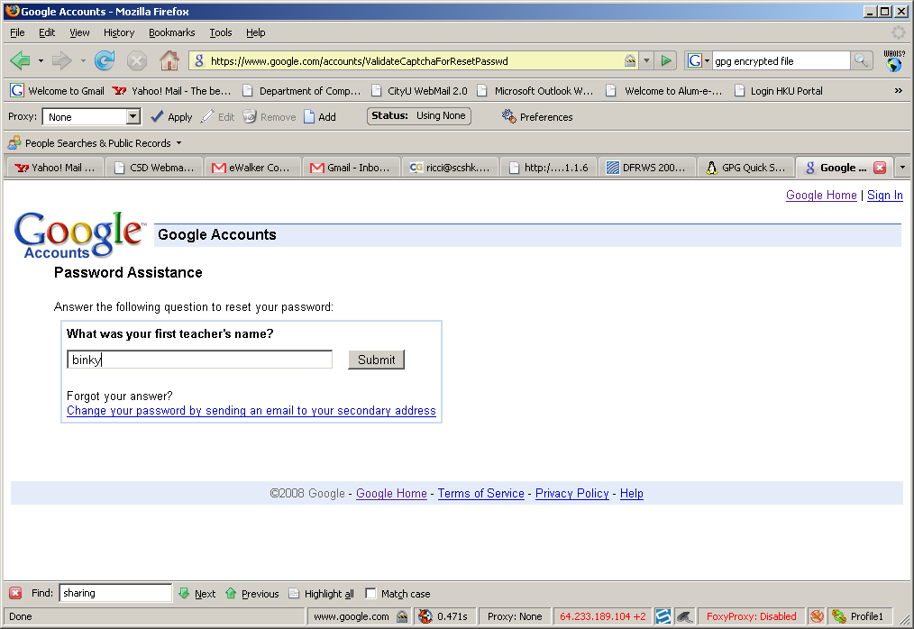
How we sign in to the Gmail?
Through the Gmail challenge and forget password answers
  The answers were found in the formhistory - binky

Slide 7
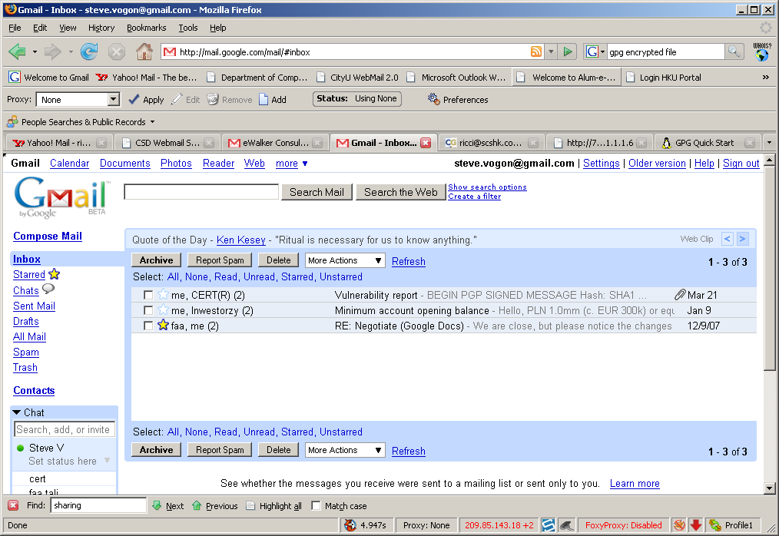
Collected from the Gmail account

Slide 8
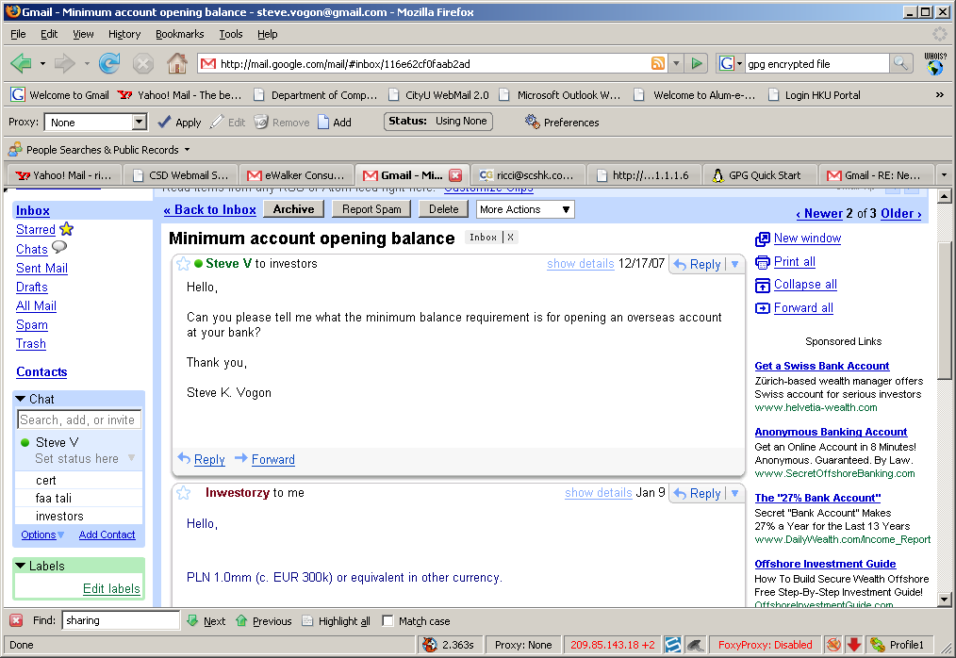
Bank Account creation email

Slide 9
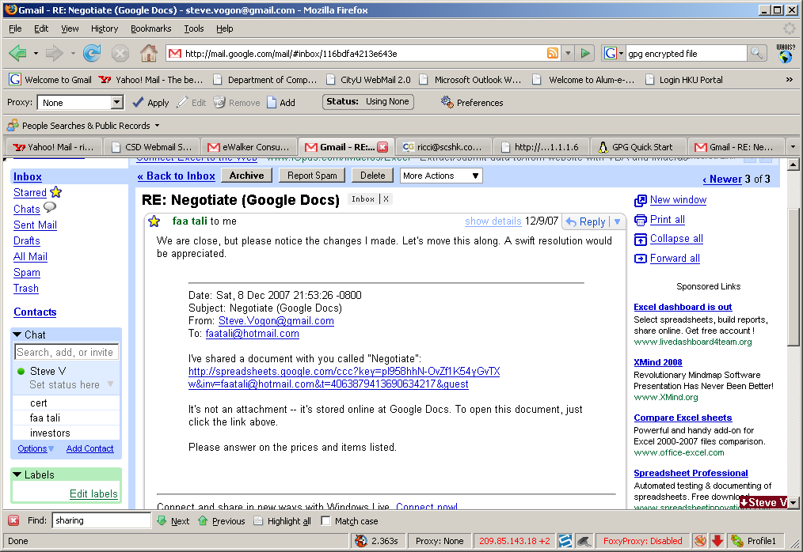
Negotiation Email

Slide 10
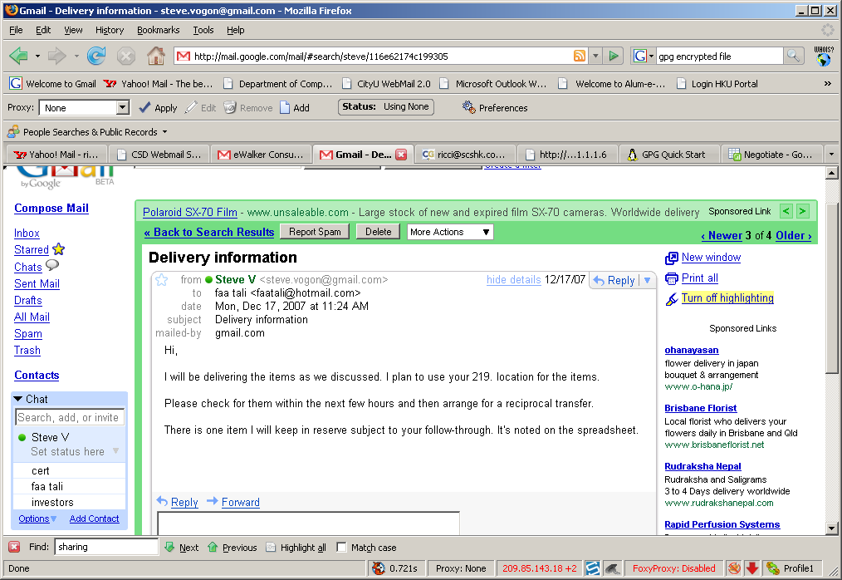
Delivered Email

Slide 11
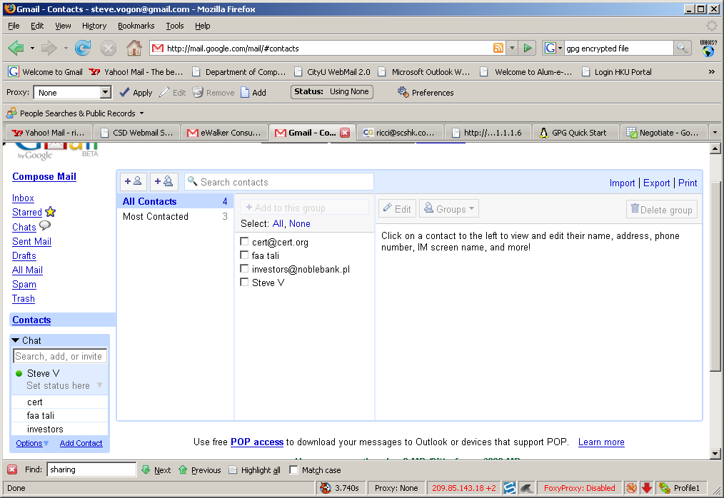
Contacts
Cert@cert.org
faatali@hotmail.com
investors@noblebank.pl
Steve.vogon@gmail.com

Slide 12
Google Spreadsheet
Document name: Negotiate
Timezone: GMT+3 Qatar
Guess: acting as the platform of negotiation between “buyer” and “seller”
  Support by the older revisions of the document
The spreadsheet is addressed to:
  From : Steve.Vogon@gmail.com
  To : faatali@hotmail.com
The content in the spreadsheet includes information about the following documents:
Asset | Type | Content
domain.xls | Access Crd | DB_INVST/Admin, DB_INVST/dba, PVT_BNK/bbthornton, PVT_BNK/vip_suport
intranet.vsd | Network Diag | Internal MX, NIDS System + Sensors, DB Farm
acct_prem.xls | Premium Accts | u-name, pw & funds; approx 700 ct
ftp.pcap | Packet Capture | Internal transaction DB FTP session, incl creds

Slide 13
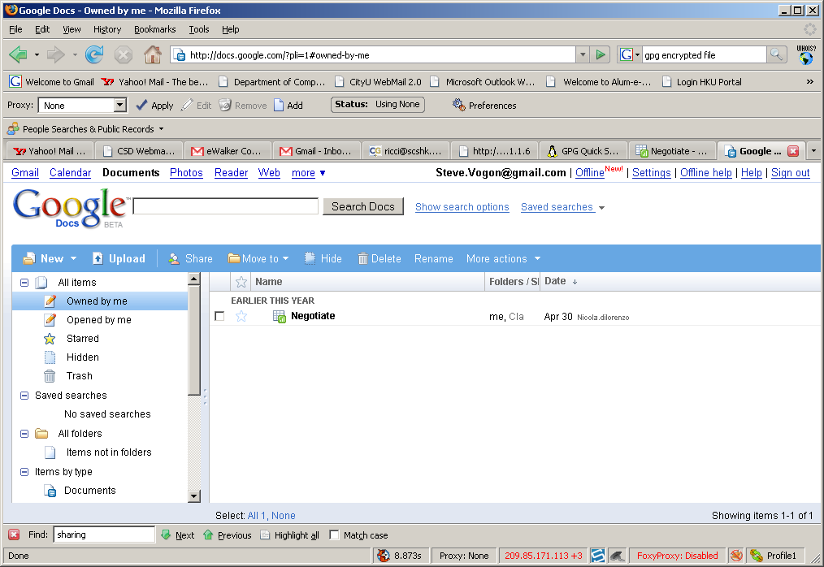
Shared document

Slide 14
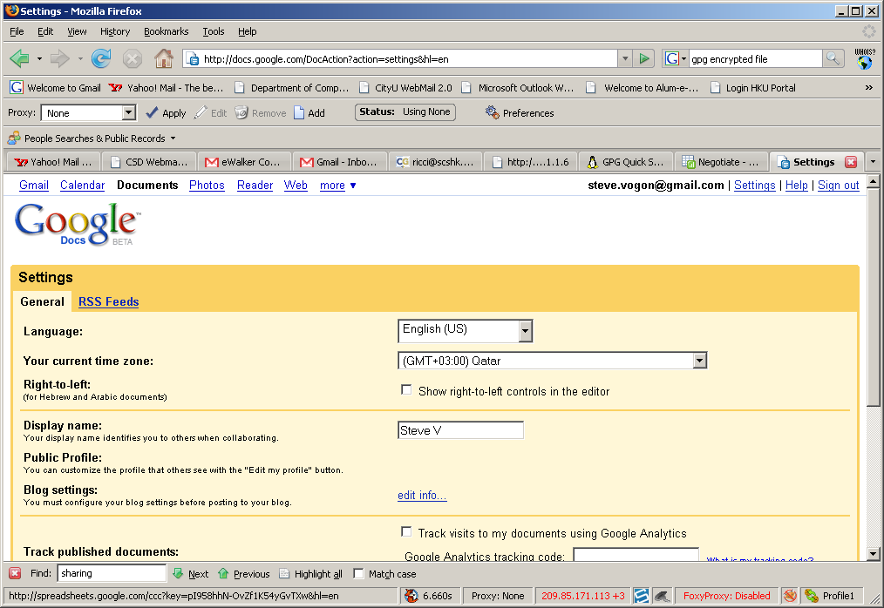
Settings at the Google Doc

Slide 15
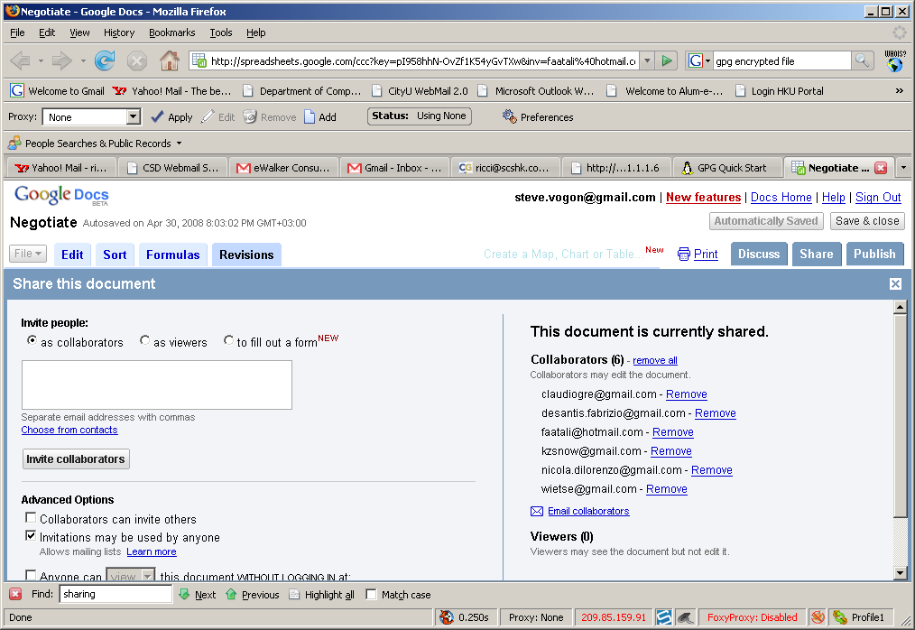
GoogleDocs (Shared)

Slide 16
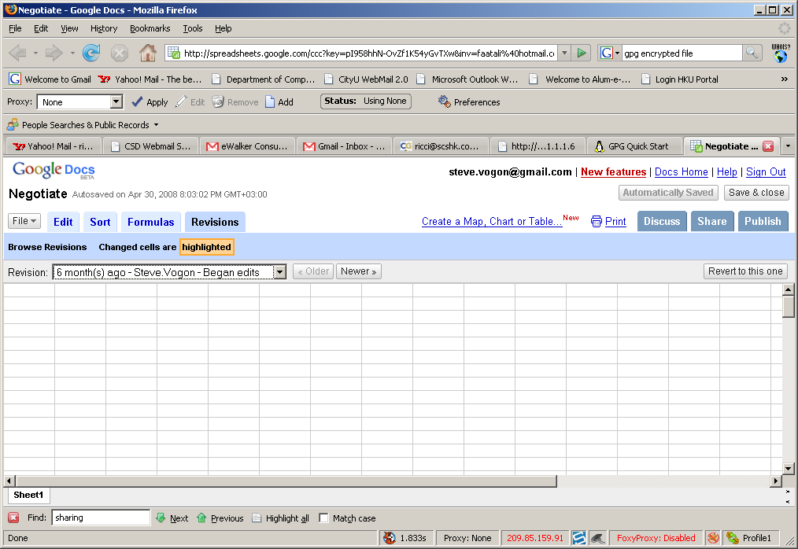

Slide 17
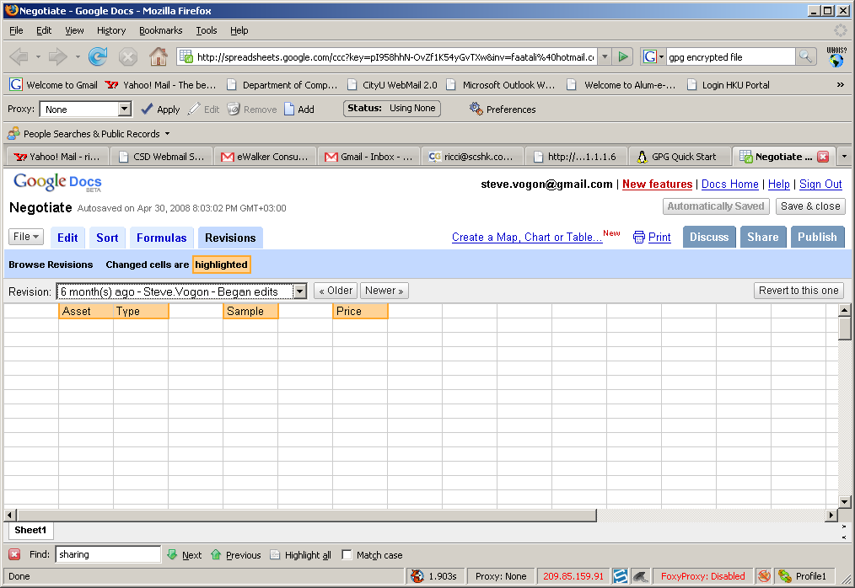

Slide 18
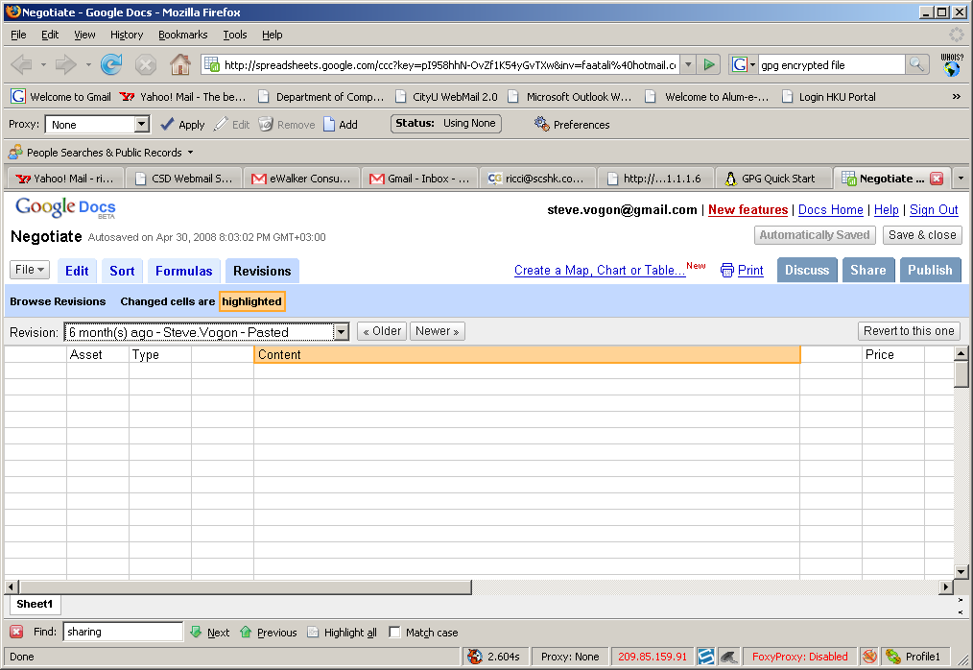

Slide 19
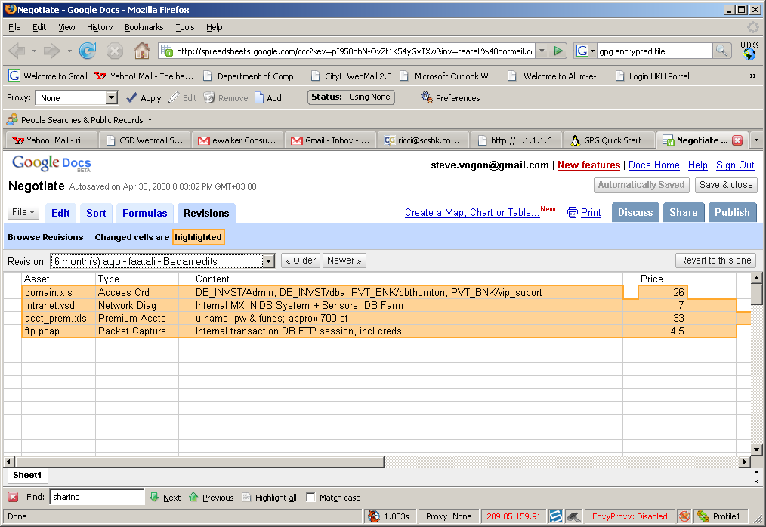

Slide 20
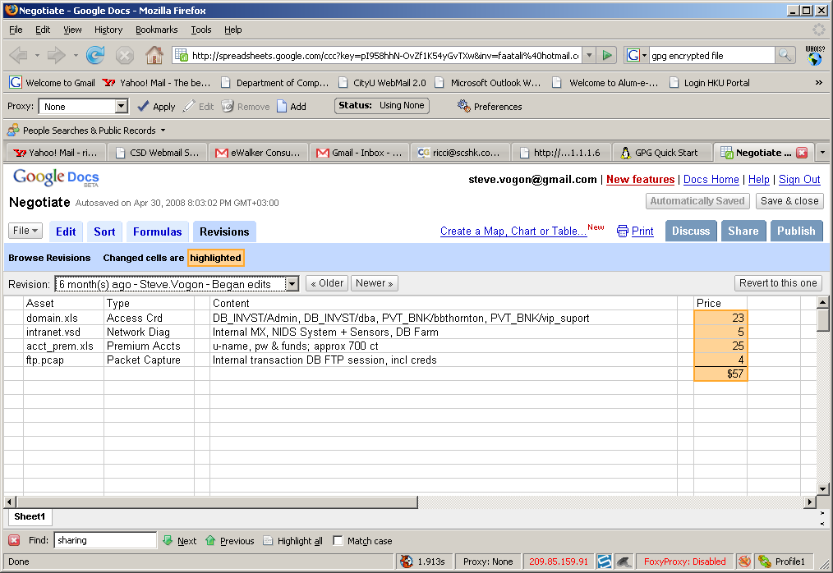

Slide 21
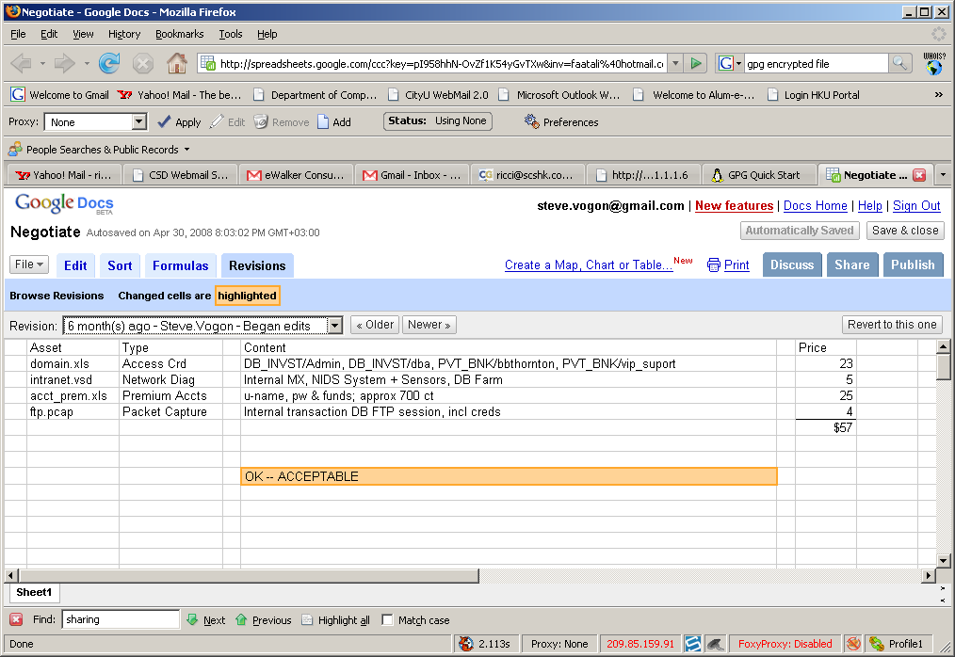

Slide 22
